Slide 1
Text Analytics Assignment 03
Lexicon and Naïve - Bayesian Text Classifier
Submitted by
Malathi M

Slide 2
OBJECTIVE/BUSINESS UNDERSTANDING
Classifying given set of text (tweets) to know whether the person is racist/sexist or non racist/sexist, which might help for political campaigning as well.

Slide 3
DATA PIPE LINE
1.1.
1.1.
1.1.
1.1.
Reading Datasets
1.Explore
2.Head
3.Tail
4.Info of the given dataset
Pre-Processing
1.Stop Word Removal and cleaning of data.
2. Shuffling of rows in Data Frame.
3.Creating subset for model.
4.Splitting data into Test and Train
5. Tokenization of Test and Train dataset
Model
1.Lexicon based model
2.Model build using TextBlob Naïve Bayes Classifier
Conclusion
1.Discussion and Conclusion of outcomes from each model.

Slide 4
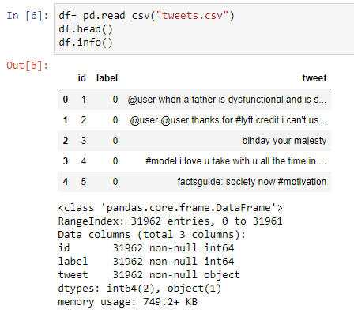
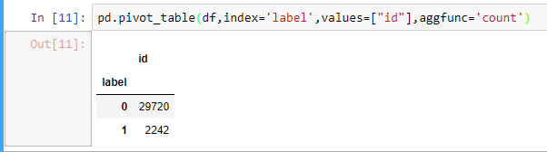
Node1-Reading Dataset
1.Given Datasets are set of tweets with class label attached with each tweet as 0 and 1 . 0 implies that the person is non racist/ sexist and 1 implies that the person is racist/sexist. Total number of tweets are 31,962.
2.Each Class count in the given sets are :
Initial/Raw Data

Slide 5
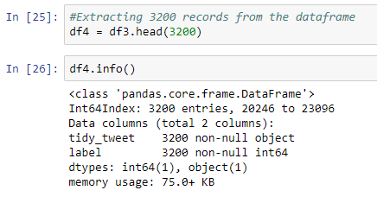
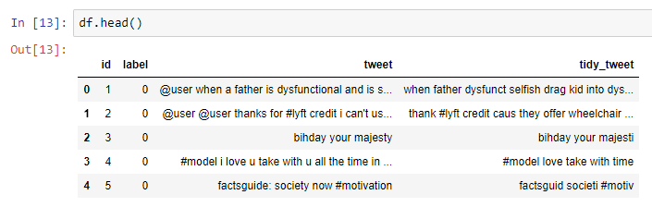
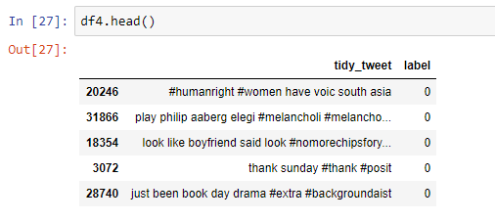
Node2-Pre-Processing
1.Stop Word removal is done, words which are having letters less than or equal to three and punctuations are removed and all texts are in lower case so normalization is not done.
2.All patterns in text are removed and twitter handles are removed(@ users)
3. Stemming of the words are done.
4.Shuffling the data frame and creating a subset for modelling.
Before and After Stop Word Removal, Stemming and removing twitter handles

Slide 6
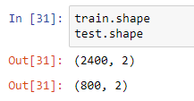
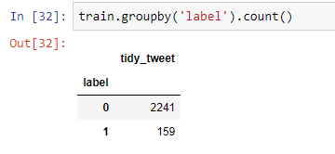
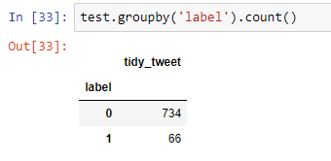
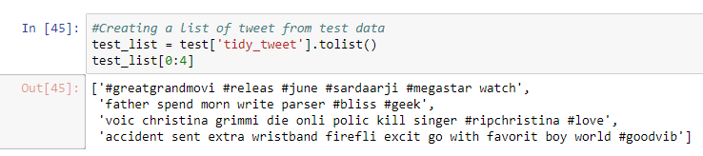
Node2-Pre-Processing
5.Splitting the new data set into test and train data in the ratio 75% and 25% respectively.
6.To create a list of tokens of cleaned
Tweet for both test and train dataset
Size of test and train dataset
Class count for train group
Class count for test group

Slide 7
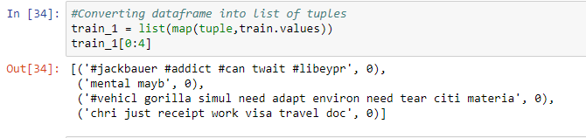
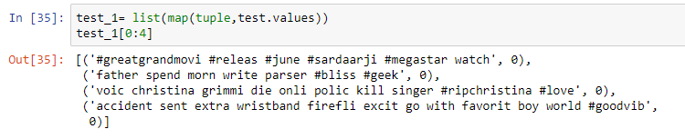
Node3- Model
Model-1 Textblob Naïve Bayes Classifier:
Textblob Classifier is a simple classifier where the train dataset(list of tuples) is fitted to train the model to train the model to classify.
Then the test dataset is passed to into textblob classifier to classify the given tweet.
Textblob classifier will also show the informative features where the each word is scored and the occurrence of the word in a sentence will help in classification of the sentence based on the weightage given to the word.
Converted data frame of test and train data into list of tuples

Slide 8
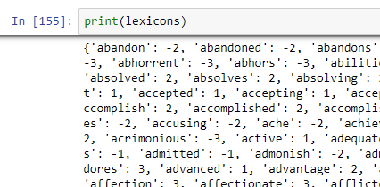
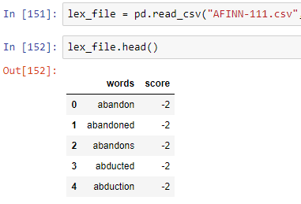
Node3- Model
Model-2 Lexicon Based Model:
Importing and creating as a standard lexicon file (Affin Dataset).
Scoring each sentence(Tokenized list of each sentence) of test datasets by words using the lexicon file.
If the score is greater than or equal to zero then the tweet will be classified as Non Racist/Sexist else
Racist /Sexist.
4.Here we cannot train the dataset and then test, directly we are modelling on test dataset and comparing the accuracy with other models.
Affin Dataset as Data frame
Affin Dataset as Dictionary

Slide 9
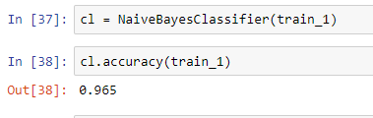

Node 4 – Discussion
Model-1 Textblob Naïve Bayes Classifier(1):
1.Accuracy for test dataset is 96.5% and accuracy for the test dataset is 92.38%
Train Accuracy of classifier
Test Accuracy of Classifier

Slide 10
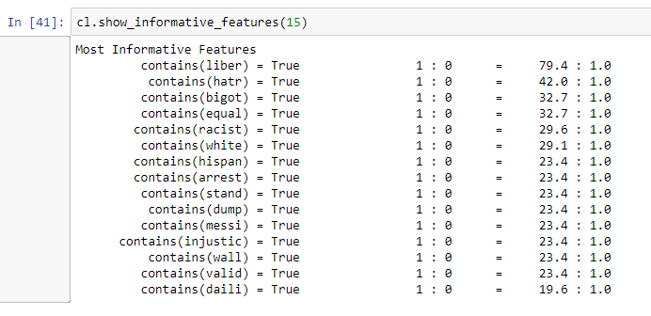
Node 4 – Discussion
Model-1 Textblob Naïve Bayes Classifier(2):
1.Informative Features give the idea that the sentence having word liberal(liber stemmed) may be Racist/Sexist cause the weightage for this word being “1” is given high.
2.Similarly if the more weightage is given to the word in a sentence which is likely to be a Non Racist/Sexist then the sentence will be classified as Non Racist/Sexist.
Informative Features for
dataset

Slide 11
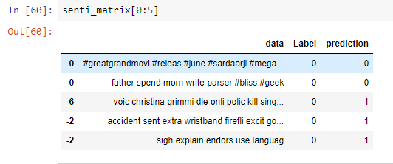
Node 4 – Discussion
Model-2 Outcome of Lexicon Based Model (1):
1.Above picture is a data frame with strength for each sentence(first column) and prediction of each sentence (last column).
Outcome Dataframe for Messages2 dataset

Slide 12
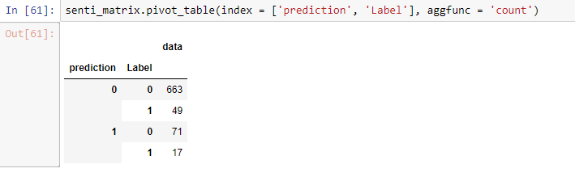
Node 4 – Discussion
Model-2 Outcome of Lexicon Based Model(2):
1.Accuracy for the output is 85%
2.True negative value i.e., Model able to detect or classify the Racist /Sexist is only 25.75%
Pivot Table of the model for prediction on test data

Slide 13
Node 4 – Conclusion
Conclusion of Models:
1.If the accuracy is taken into account then the Textblob naïve Bayes classifier is most likely to be a good model to classify
2.And also Textblob Classifier gives weightage for each word likely to be Racist/Non Racist
3.Lexicon Based Classifier was able to classify only 25.75% of racist tweet.
4.Also,its may also depend on the lexicon/dictionary used for the classifier.
Demerits of Textblob classifier:
1.Draw back of the texblob classifier is that, we cannot know the recall value for the classes for evaluation.

Slide 14
GitHub Link:
https://github.com/MalathiMuniraju/hello-world/blob/master/Text%20Analytics%20Assignment%2003.pptx
THANK YOU

